Slide 1
In the Medical Board Hot Seat!
Kathleen Stillwell, RN, MHSA, MPA, CPHRM
Richard Cahill, Esq.
Keith Carlson, Esq.
Jehan Jayakumar, Esq.
Michael Fitzgibbons, MD
Jeffrey Lauber, MD
G. Scott Smith, MD

Slide 2

AMA - Accreditation, Disclosure, and Disclaimer
The Doctors Company is accredited by the Accreditation Council for Continuing Medical Education (ACCME) to provide continuing medical educational activities for physicians.
The Doctors Company designates this activity for a maximum of 1.5 AMA PRA Category 1.0 Credits™. Physicians should claim only the credit commensurate with the extent of their participation in the activity.
No individual in a position to control or influence the content of this activity has reported relevant financial relationships with commercial interests. No commercial support was provided for this activity.
This program is being offered for informational and educational purposes only from a Patient Safety Risk Management perspective and does not constitute legal advice. Laws vary from state to state, actual clinical situations often involve subtle differences and nuances from program scenarios or recommendations, and the recommendations provided in this activity may not apply to all practice situations. In complex circumstances, which present significant potential for an adverse event or litigation, TDC and the faculty recommend you consult directly with your corporate or personal counsel for professional legal guidance.
2

Slide 3
ADA - Accreditation, Disclosure, and Disclaimer
This continuing education activity has been planned and implemented in accordance with the standards of the ADA Continuing Education Recognition Program (ADA CERP) by The Doctors Company.
The Doctors Company is an ADA CERP Recognized Provider. ADA CERP is a service of the American Dental Association to assist dental professionals in identifying quality providers of continuing dental education. ADA CERP does not approve or endorse individual courses or instructors, nor does it imply acceptance of credit hours by boards of dentistry. Concerns or complaints about a CE provider may be directed to the provider or to ADA CERP at ADA.org/CERP.
The Doctors Company designates this activity for 1.5 continuing education credits.
No individual in a position to control or influence the content of this activity has reported relevant financial relationships with commercial interests. No commercial support was provided for this activity.
This program is being offered for informational and educational purposes only from a Patient Safety Risk Management perspective and does not constitute legal advice. Laws vary from state to state, actual clinical situations often involve subtle differences and nuances from program scenarios or recommendations, and the recommendations provided in this activity may not apply to all practice situations. In complex circumstances, which present significant potential for an adverse event or litigation, TDC and the faculty recommend you consult directly with your corporate or personal counsel for professional legal guidance.
3

Slide 4
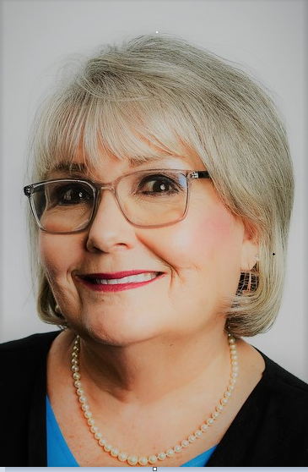
Kathleen Stillwell, RN, MPA, MHSA, CPHRM
Senior Patient Safety Risk Manager
Kathleen Stillwell earned Master’s Degrees in Public Administration and Health Services Administration. She is a registered nurse and Certified Professional Health Care Risk Manager (CPHRM). Ms. Stillwell is a nationally recognized expert in healthcare risk management with over 38 years of experience in clinical risk management, professional liability claims management, compliance, and high-risk underwriting. Her expertise includes hospitals, medical practices, and integrated healthcare organizations.
Ms. Stillwell serves on Chapman University, Leadership Council for Crean College of Health and Behavioral Sciences in Irvine, CA. She also serves on the University of California Riverside Advisory Board for Women in Leadership Program. Kathleen is a member of Brandman University Nurse Advisory Board, and a volunteer coach for physicians and nurses for the California Medical Association Care 4 Caregivers program. She has served as faculty for the American Society for Healthcare Risk Management and is published in the American Hospital Society Risk Management Handbook for Healthcare Organizations.
Kathleen has held numerous leadership positions with national and state risk management and quality organizations, including past Board Member for the American Society for Quality (ASQ), Healthcare Division, President of the CA State Patient Care Assessment Council, Board member for the California League of Nursing, adjunct faculty for Woodbury University and the University of San Francisco. She served on the Advisory Board of King International, Inc., and is a Charter Member of the Business Renaissance Institute.

Slide 5
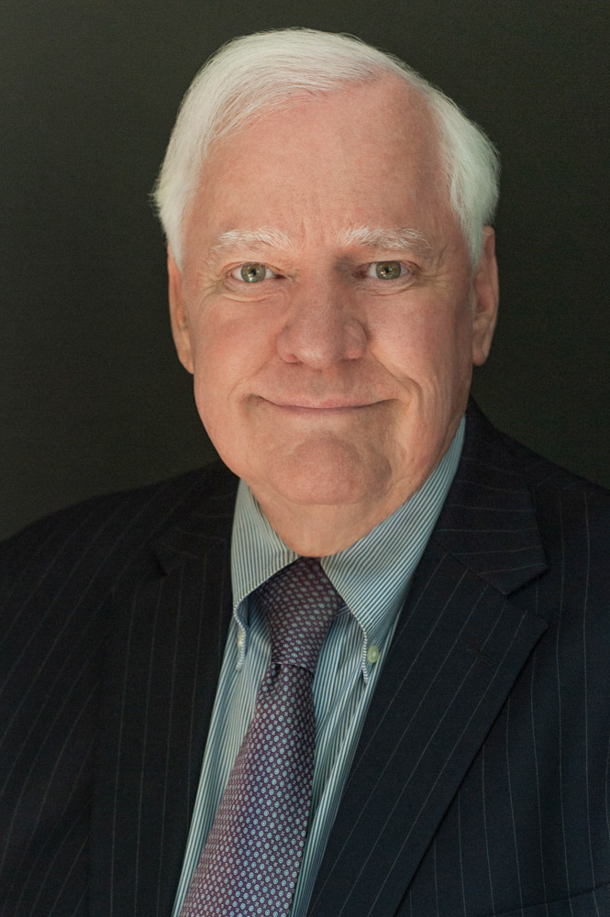
Richard Cahill, Esq.
Vice President and Associate General Counsel
Richard Cahill received his undergraduate degree (summa cum laude) from UCLA in 1975 and his Juris Doctorate from Notre Dame Law School in 1978. He served as a deputy district attorney in California at the outset of his career and was subsequently appointed as counsel on the Central Legal Staff of the Nevada Supreme Court before entering private practice in southern California.
Mr. Cahill has specialized in various facets of health care litigation for more than 35 years, including the defense of hospital and physician professional liability claims, managed care contract disputes, network privileges issues and related business torts. His principal clients included Cigna Health Plans, Kaiser-Permanente and Tenet Healthcare Systems. He has completed in excess of 185 trials and binding arbitrations during his career with a combined win-rate of 92% and has been appointed as an arbitrator in more than 350 cases involving complex healthcare issues. Mr. Cahill is Vice President and Associate General Counsel with The Doctors Company and provides legal support to the Claims and Patient Safety Departments, oversees company appellate litigation, researches and submits original content for publication and lectures frequently around the country on topics related to the health care community. He has a preeminent rating with Martindale-Hubbell, the premiere peer-reviewed attorney rating service in the United States.

Slide 6
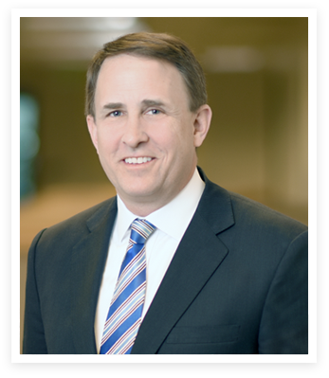
Keith Carlson, Esq.
Keith W. Carlson, founding partner with the law firm of Carlson & Jayakumar LLP, practices all aspects of employment law, healthcare law, and related litigation. Mr. Carlson deals extensively with general employment issues, as well as employment and corporate issues affecting the healthcare industry. He also has experience – in both state and federal courts – in matters involving trade secrets, unfair competition, wage-and-hour claims, sexual-harassment claims, race-discrimination claims, disability-discrimination claims, wrongful-termination claims, business litigation, and representation before administrative agencies.
In addition to his litigation experience, Mr. Carlson regularly advises clients on contractual matters affecting professional employee compensation, specifically with respect to compliance with federal and state fraud-and-abuse laws. He is a regular guest lecturer at both Cleveland Chiropractic College and the Southern California University of Health Sciences (LACC) on multi-specialty practices, employment law, and practitioner-compensation issues. In addition to healthcare topics, Mr. Carlson frequently speaks on employment and political issues. He is a member of the Orange County Bar Association, Labor and Employment Section, and the National Association of Chiropractic Attorneys.
Mr. Carlson received his J.D. in 1997 from the University of California, Los Angeles School of Law. Mr. Carlson received his B.A. from the University of California, Los Angeles where he graduated magna cum laude and was selected to Phi Beta Kappa. He was also awarded the Chancellor’s Service Award, for excellence in community service. Mr. Carlson is highly involved in his community. He has served on both the Chapman and Whittier Law School’s Board of Visitors, the Irvine Valley College Foundation, and Santa Ana Unified School District’s Bond Oversight. He currently serves on the Advisory Board for Pacifica Christian High School and is Chairman of the California Republican Lawyers Association.

Slide 7
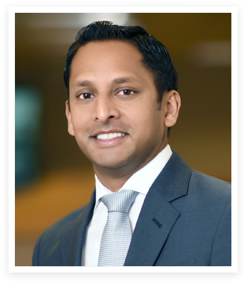
Jehan Jayakumar, Esq.
Jehan N. Jayakumar is a founding partner of Carlson & Jayakumar LLP, where he practices all aspects of employment law, healthcare law, and related litigation. Mr. Jayakumar deals extensively with general employment issues, as well as employment and corporate issues affecting the healthcare industry. He also has experience in matters involving race discrimination, disability discrimination, sexual harassment claims, wage-and-hour claims, wrongful termination claims, business litigation, and representation before administrative agencies.
In addition to his litigation experience, Mr. Jayakumar regularly advises clients on contractual matters affecting employee compensation. He has also been a guest lecturer for H.J. Ross Company, Inc. on employment law and healthcare issues. Mr. Jayakumar is a member of the Orange County Bar Association, Labor and Employment Section, and the National Association of Chiropractic Attorneys. Mr. Jayakumar received his J.D. in 2002 from the University of California, Davis, School of Law. Mr. Jayakumar received his B.A. degree from the University of California, Irvine in 1999. Prior to joining Carlson & Jayakumar, Mr. Jayakumar was an associate at Carlton DiSante & Freudenberger LLP where he focused on labor and employment litigation (including all forms of discrimination and harassment, wrongful discharge and wage-and-hour litigation), and employer advice and counseling.

Slide 8
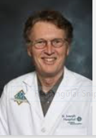
Michael Fitzgibbons, MD
Dr Fitzgibbons is a highly respected Infectious Disease specialist in Santa Ana. He is affiliated with multiple hospitals in the area, including Providence St Joseph- Hospital Orange and Chapman Global Medical Center. Dr Fitzgibbons received his medical degree from Georgetown University School of Medicine and completed his internship, residency, and fellowship at UCI Medical Center.
Dr Fitzgibbons is an active, long-term supporter of the Orange County Medical Association and is also a California Medical Association Alternate Delegate.

Slide 9
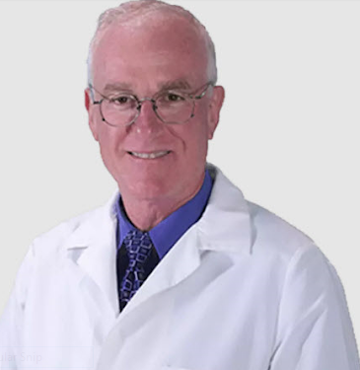
Jeffrey Lauber, MD
Dr. Jeffrey Lauber, MD a highly respected, Board Certified, dermatologist in Newport Beach, CA has 38 years of experience. He graduated from Keck School of Medicine, University of Southern California in 1985, and completed his residency at Tulane University Hospital and Clinics. Dr. Lauber is affiliated with Hoag Hospital Newport Beach. Dr. Lauber speaks Portuguese, and Spanish.
Dr. Lauber specializes in the diagnosis and treatment of diseases of the skin. He performs cosmetic procedures, including hair removal, laser therapy, cosmetic filler injections, cryosurgery, tattoo removal, and phototherapy.

Slide 10
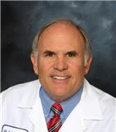
G. Scott Smith, MD, FAAFP
Dr. B. Scott Smith is a highly respected Family Practice physician with St Joseph Heritage Medical Group in Orange. He graduated from UC Irvine and completed medical school at St Louis University, School of Medicine. Dr Smith is Board Certified in Family Practice medicine and has contributed his expertise through many years of outstanding leadership roles with St Joseph Hospital of Orange, Chapman General Hospital, and St Joseph Heritage Medical Group.
A great supporter of education for physicians, Dr. Smith has been Chief Education Coordinator for the St Joseph Annual Primary Care CME Conference, 2019-2023.

Slide 11
Objectives
After completing this activity, learners will be able to:
Evaluate the most frequent types of complaints made to the Medical Board
Respond appropriately to a Medical Board complaint
Recognize the importance of documentation necessary to respond to a Medical Board complaint
Develop an action plan to improve staff documentation, and my own documentation, in two specific areas of the medical record

Slide 12
The man who represents himself
has a fool for a client.
Abraham Lincoln
16th President of the United States

Slide 13
Disclosure for Speakers
The Doctors Company would like to disclose that no one in a position to control or influence the content of this activity has reported relevant financial relationships with commercial interests.
The information and guidelines contained in this activity are generalized and may not apply to all practice situations. The faculty recommends that legal advice be obtained from a qualified attorney for specific application to your practice. The information is intended for educational purposes and should be used as a reference guide only.

Slide 14
Cast of Characters
In the Hot Seat…
Attorney Keith Carlson, Esq.
Attorney Jehan Jayakumar, Esq.
Physician Michael Fitzgibbons, MD
Physician Jeffrey Lauber, MD
Physician Glen Scott Smith, MD

Slide 15

A Medical Board Investigation Changes Your Life
Investigation may last 18-24 months
  Being under investigation by the Medical Board takes a major toll on your personal and professional life
  The very best of physicians get investigated by the Medical Board
  Being involved in a Medical Board investigation is a deeply personal and emotional experience
  Many Medical Board complaints by patients who want to retaliate due to dissatisfaction with physician or office staff

Slide 16
CA Medical Board Receives an Average of 40 Complaints a Day
The Board does not have jurisdiction over billing/fee disputes, general business practices (contracts, office policies, appointment times/duration, etc.) or personal conflicts, unless the behavior in question interferes with the safe delivery of health care
The Board cannot assist with any coordination of patient care or provide financial compensation
You must fill out a separate complaint form for each physician or other healthcare provider you wish to file a complaint against
https://www.mbc.ca.gov/Download/Reports/enforcement-report-2023.pdf

Slide 17
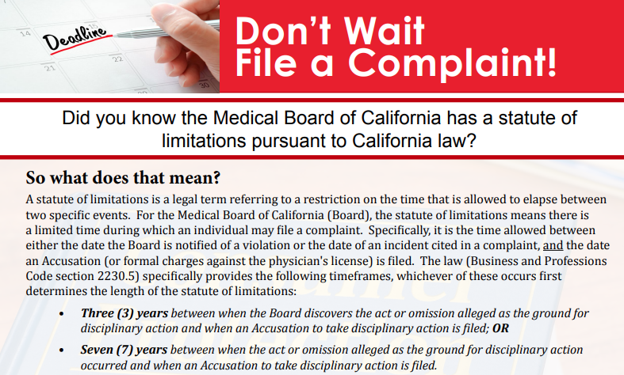
https://www.mbc.ca.gov/Resources/brochures/File-a-Complaint.aspx

Slide 18
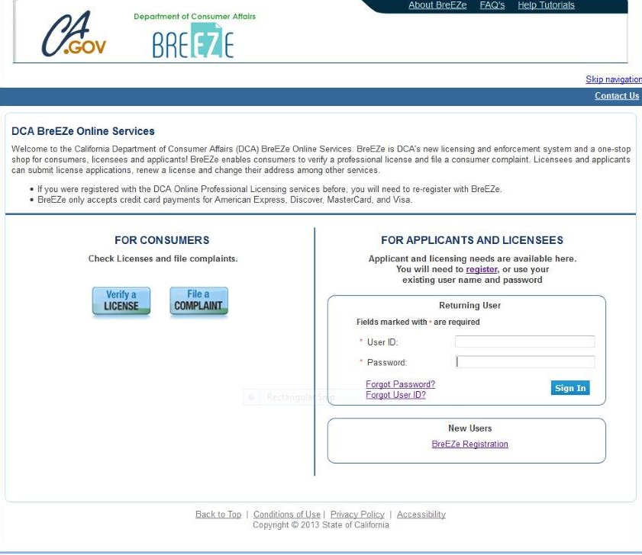
https://www.mbc.ca.gov/Resources/brochures/File-a-Complaint.aspx

Slide 19
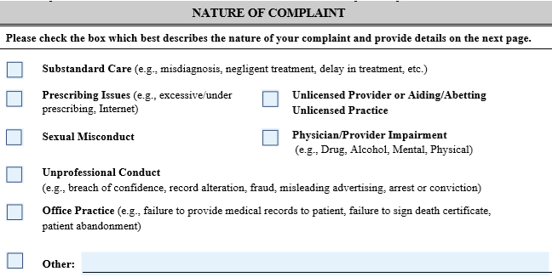
Medical Board of California Consumer Complaint Form

Slide 20

What Do Physicians Say?
Feelings of anxiety, worry, insomnia
It was patient retaliation
Medical Board is not my ally or advocate
Loneliness and isolation
Zaps the joy of practicing medicine
Negative effect on marriage and family
Concerned with adverse affect on practice
The prolonged process for Board complaint investigation can take 12-18 months

Slide 21
Medical Board Responsibilities

Slide 22
Medical Board Responsibilities
Four primary categories
  Complaint Unit
  Investigation
  Disciplinary Action
  Probation Monitoring
https://www.mbc.ca.gov/Consumers/

Slide 23
Medical Board Investigates Complaints
Medical doctors (MDs)
Licensed Midwives
Polysomnographic trainees, technicians, and technologists
Research psychoanalysts

Slide 24
Complaints to Medical Board
Quality of Care: Misdiagnosis, treatment/medication causing side effects, surgical complications, negligent care, etc.
Office Practice: Failure to sign death certificate, failure to provide records, misleading advertising, posting on social media, violation of HIPAA
Inappropriate Prescribing: Failure to check CURES
Unprofessional Conduct
Provider Impairment: Under the influence of drugs or alcohol, mental or physical impairment
Sexual Misconduct
Unlicensed Activity: Aiding and abetting unlicensed practice, unlicensed provider
https://www.mbc.ca.gov/Consumers/file-a-complaint

Slide 25
To Consumers: The Board does not have jurisdiction over the following:
  Billing/fee disputes, general business practices
  Contracts, office policies
  Appointment times/duration, etc.
  Personal conflicts, unless behavior in question interferes with the safe delivery of healthcare
  Please contact your insurance company or individual healthcare provider’s office to resolve general billing or fee disputes
https://www.mbc.ca.gov/Consumers/file-a-complaint/

Slide 26
To Consumers: The Board does have jurisdiction over the following:
  Medical Board of California is charged with ensuring that physicians are practicing medicine within "the standard of practice in the medical community."
  Medical Board's authority is limited to pursuing administrative action against the physician's license to practice medicine:
      Suspension
      Revocation
      Issuing citations for violations of law
      Requiring probation or monitoring
https://www.mbc.ca.gov/FAQs/?cat=Consumer&topic=Complaint%3A%20Review%20Process

Slide 27
In the Hot Seat!
Scenario I

Slide 28

Complaint
Failure to provide patient with medical records within 15 days as required by HIPAA
Practice provided protected health information over the phone to unauthorized individual

Slide 29
Allegations: Violation of patient privacy and confidentiality and
Failure to follow federal and state HIPAA requirements
Investigation Findings:
Unauthorized release of patient information to caller
Physician staff posted response to patient posting on Yelp
No Privacy Officer designated in practice
No Notice of Privacy Acknowledgement in medical record
No Annual HIPAA Security Assessment in medical practice
No documentation of HIPAA staff training
Failed to provide medical records within 15 days of written request
No HIPAA Policy in practice
No Business Associates Agreements in place

Slide 30

Patient Safety Considerations
Designate a Privacy Office for practice
Maintain HIPAA policy and procedures
Ensure appropriate HIPAA training for staff at time of hire and update each year
Make sure Business Associates Agreements are in place
Acknowledgement of Notice Privacy
Perform annual Security Assessment for medical practice

Slide 31
In the Hot Seat!
Scenario II

Slide 32

Complaint
Unprofessional conduct during office exam
Multiple orders for scheduled drugs without checking CURES

Slide 33
Allegations of Fraud in Medical Records
Investigation Findings:
Billing for services not documented
EHR shows copy and paste
Meta Data shows entries after Medical Board complaint letter received
Telephone calls and texts not documented in medical record
No visit note for some visits, no problem list documented
No documentation of chaperone present during exam of intimate areas

Slide 34
Patient Safety Considerations
Document all services provided
Do not bill for undocumented services
Do not copy and paste in EHR without explanation
Note “late entry” when entering >24 hours after visit
Document chaperone present during intimate examination
    If patient refuses chaperone, document using quotes with patient’s words

Slide 35
In the Hot Seat
Scenario III

Slide 36

Complaint
Inappropriate prescribing of scheduled drugs
Failure to follow CURES prescribing requirements

Slide 37

Allegations: Drug Overdose Resulting in Death of Patient
Investigation Findings:
No drug history documented
No CURES report before first Rx ordered
No CURES report for refills
No documentation of warning of drug-drug interactions
No documentation about driving while taking scheduled drug
Release of protected health information to unauthorized person on the phone
No Narcan prescribed

Slide 38
Patient Safety Considerations
Document drug history, including Rx, OTC, supplements, recreational drug use, alcohol
Register for CURES…never share your password
CURES report prior to first Rx, every four months for refills
Document warning patient of driving and operating equipment while taking Rx
Consider a written contract with patient when prescribing scheduled drugs
Prescribe Narcan as required by CA law
Consider referral to pain management
Maintain compliance with HIPAA federal and state regulations

Slide 39
The Patient’s Point of View
The physician is responsible and liable for everything that happens in the practice
You are the one who will be reported
HIPAA violations carry steep fines and penalties
Privacy violations damage your reputation
You will be in the news
You are responsible when your staff makes a mistake
You are responsible if your staff is not trained
It is your practice…it is your reputation…it is your future

Slide 40

Social Determinants of Health
Housing
Health Insurance
Health
Literacy
Community
Discrimination
Davis B. Discrimination: A Social Determinant Of Health Inequities. Health Affairs Blog. 2/25/2020

Slide 41
Culture and Health Literacy: Important Elements of Care
Literacy
People with limited English proficiency
People with low health literacy
Inclusion
People who have a sensory impairment
Represents the practice population
Respect
Person-first language
www.chttps://thinkculturalhealth.hhs.gov/resources/videos/using-language-access-services

Slide 42
A good reputation is more valuable than money
Publilius Syrus
Latin writer
85 BC-43 BC

Slide 43


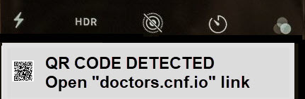
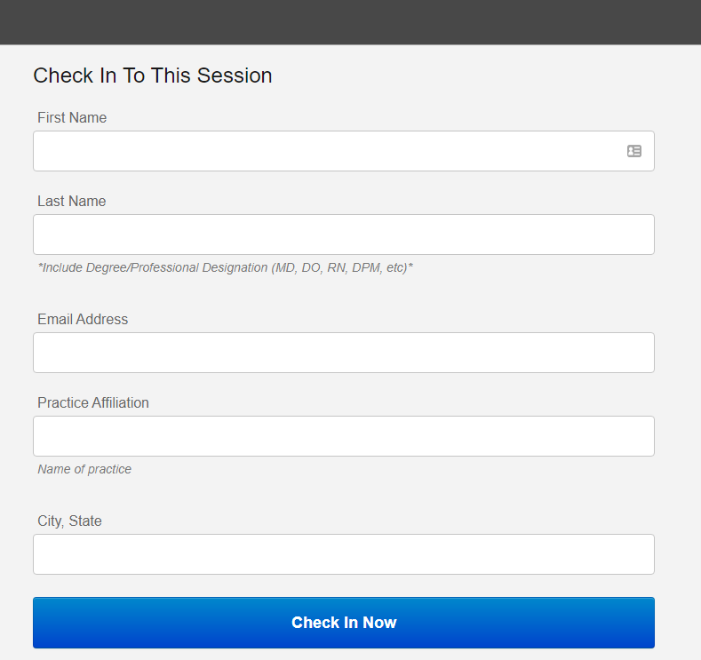


Please sign-in for CME session and complete evaluation by 5 pm November 9, 2023, to claim CME credit
To receive CME Credit, use your personal device (smartphone, tablet, laptop) to record attendance and receive CME Credit
1. Type doctors.cnf.io in URL/ search bar or use camera on smartphone to scan the QR code
2. Complete the form and select “Check in Now”
Scan image
Link to CME Evaluation
https://doctors.cnf.io/
CME certificates are sent to the registered email address 7-10 business days after submission. Please contact Tina Wheeler at twheeler@thedoctors.com with any additional questions regarding this program.
.

Slide 44
Our Mission is to Advance, Protect, and
Reward the Practice of Good Medicine.
We’re Taking the Mal Out of Malpractice.
Thank you! kstillwell@thedoctors.com
800-421-2368, ext. 4254
Cell 562-900-3008

